Slide 1
Africa Government and Economics vocabulary
•SS7CG1 - The student will compare and contrast various forms of government.
•SS7E1.a - Compare how traditional, command, and market economies answer the economic questions of (1) what to produce, (2) how to produce, and (3) for whom to produce.
Bell-Ringer – What are the similarities and differences between a parliamentary and presidential democracy?

Slide 2
Pre-Test Instructions
Much of the vocabulary that we will be learning is review, so we need to see what you remember!
Follow the instructions on the paper, there is no talking during the pre-test.
When finished, raise your hand and remain quiet.

Slide 3
Notetaking
The notes for today will be a mixture of the handout given to you and Frayer Model.
Handout – Follow along and place vocabulary word in the correct spot.
Frayer Model – Definition, Definition IYOW, Use in a Sentence, Drawing.
Your vocabulary quiz will be THIS FRIDAY!

Slide 4
Government
Represents citizen participation in government. A government where the ruler has absolute power to do whatever he or she wishes and makes/enforces whatever laws chosen. Government by one. ____________________________

Slide 5
Government
A type of government system where a single ruler or party has total control; usually uses military to enforce power. _______________________

Slide 6
Government
Represents a way government distributes power. This is a government system in which the central government has all of the power. _______________________

Slide 7
Government
A government in which God is seen as the true leader of the government and the country’s religious leaders serve as the political leaders. ______________________

Slide 8
Government
A type of government system where the ruler is a king or queen and serves as the “figure head” of government. Powers and ability to rule are limited by the constitution. ____________________________

Slide 9
Government
A state in which the supreme power is held by the people and their elected representatives, and which has an elected or nominated president. ______________________

Slide 10
Government
Way government distributes power. Local governments hold all of the power and the central government depends on the local governments for existence. ____________________

Slide 11
Government
Represents citizen participation in government. A government system where people play a much greater role in deciding who rules and what decisions are made. Government by all. ________________________

Slide 12
Government
A government system where Parliament is the legislature and the leader of the government is the Prime Minister who is selected by the majority party in Parliament. __________________________________

Slide 13
Government
Represents citizen participation in government. A government system where a political party or other small group rule the government and control. “Government by a few.” ____________________

Slide 14
Government
A type of government system where the Congress is the legislature and the leader of the government is the President who is voted in a separate election. ____________________________

Slide 15
Government
Way government distributes power. Political system in which power is shared equally among different levels of government. ______________________

Slide 16
Government
A type of government system where the hereditary ruler is the king or queen, who has a “divine right” (God given right) to rule the government and has total control/power. ____________________________________

Slide 17
Economics
Economic decisions are based on customs and traditions, handed down from generation to generation. _________________________

Slide 18
Economics
Taxes placed on imported goods (items coming into the country). __________________

Slide 19
Economics
Some decisions are left to individuals and some are made by the government (mixture of market and command). _________________________

Slide 20
Economics
Ban on trade with another country. ____________________

Slide 21
Economics
Economic decisions are made by the government or small group of people - little or no private ownership of property. ________________________

Slide 22
Economics
Restrictions on the amount of a good that can be imported into a country. It can cause shortages that cause prices to rise. ____________________

Slide 23
Economics
Relies on the individuals (consumers) and businesses (market/producers) to make its economic decisions. ______________________

Slide 24
Economics
The set of skills which an employee acquires on the job, through training and experience. ________________________

Slide 25
Economics
The percentage of people who can read and write in a country. _______________________

Slide 26
Economics
Factories and machinery that help speed up the process of production. _________________________

Slide 27
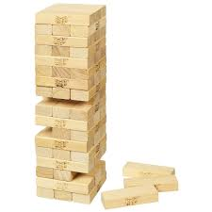
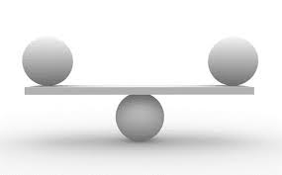
Frayer Model
Stability – Being stable; strong; solid; firm; secure.
Sometimes we rank governments on government stability. What do you think that means?

Slide 28
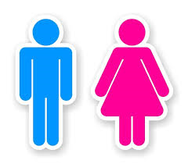
Frayer Model
Gender – Being either male or female.
Often when we look at literacy rate, we look at the differences in the genders.

Slide 29
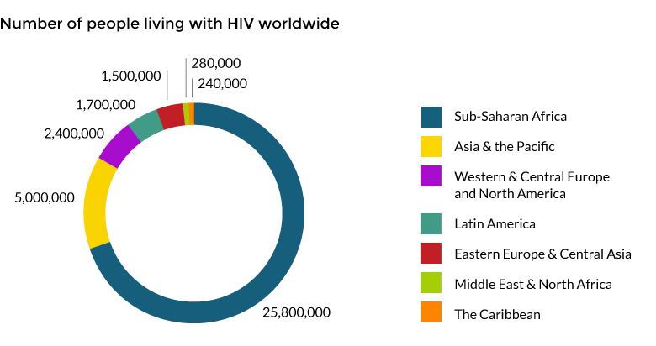
Frayer Model
AIDS - Acquired Immunodeficiency Syndrome; a disease in which there is a severe loss of the body's cellular immunity, greatly lowering the resistance to infection. Currently there is no cure for AIDS.
AIDS is very common in Africa.

Slide 30
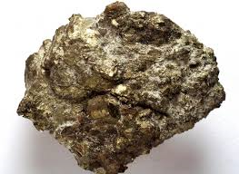
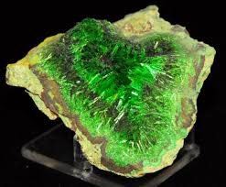
Frayer Model
Uranium - a very heavy metal which can be used as an abundant source of concentrated energy.

Slide 31
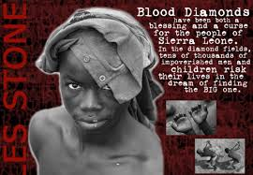
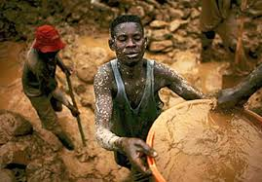
Frayer Model
Conflict Diamonds - a term used for a diamond mined in a war zone and sold to finance war efforts. Also called blood diamonds.

Slide 32
Closing Activity
Some of you will have the name of one of our vocabulary words. Wear that name badge on your shirt.
Some of you will have definitions.
Match the definition with the person wearing the name badge and stand next to each other along the side of the room once you have found that person.
Do NOT use your definition sheet to help you!!!

