Slide 1
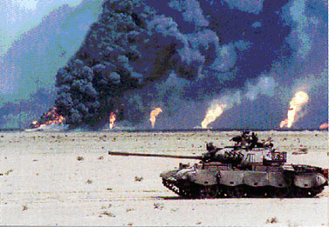
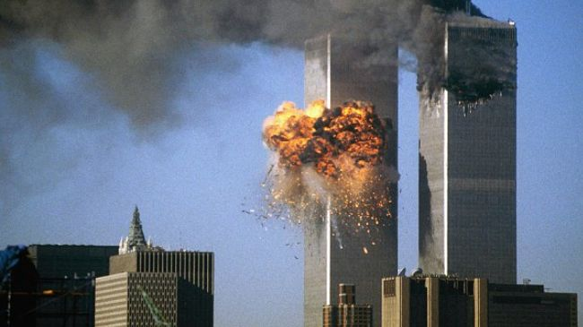
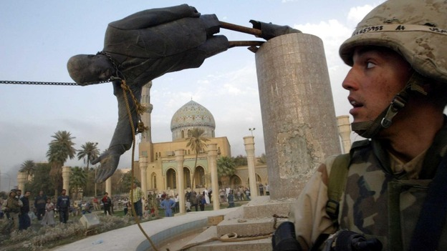
American Wars Day 1
•SS7H2.d - Explain U.S. presence and interest in Southwest Asia; include the Persian Gulf conflict and invasions of Afghanistan and Iraq.
Bell-Ringer – Which was the United States’ First war with Iraq: Operation Iraqi freedom or the Persian gulf war?

Slide 2
Work Session (Will last from Tuesday-Thursday)
*Station 1 (videos) we will do as a class
You are to take good notes about Saddam Hussein and Osama bin Laden during the videos. Make sure you write down who they are and what countries/groups they belong to.
*Station 2 – Persian Gulf War – do the readings and complete the questions.
*Station 3 – Invasion of Afghanistan – do the readings and complete the questions.
*Station 4 – Operation Iraqi Freedom – do the readings and complete the questions.
*Create Timeline
*R.A.C.E. on “How are land and religion reasons for continuing conflict in the Middle East?”
*Go over Rubric
*This will be considered a QUIZ Grade (30% of grade)

Slide 3
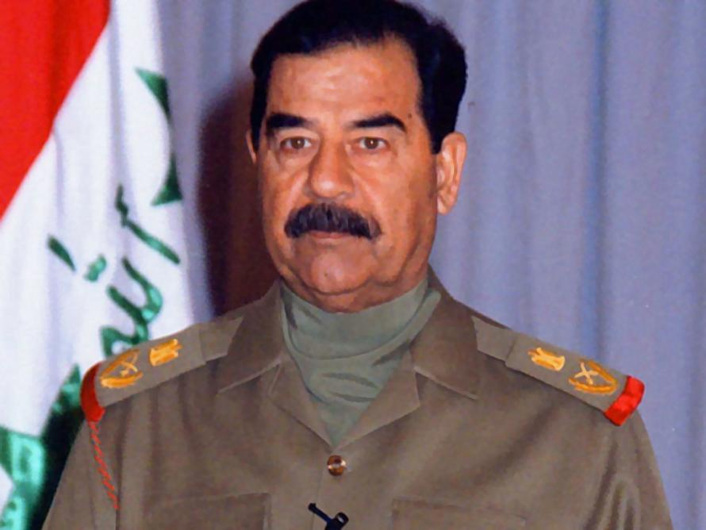
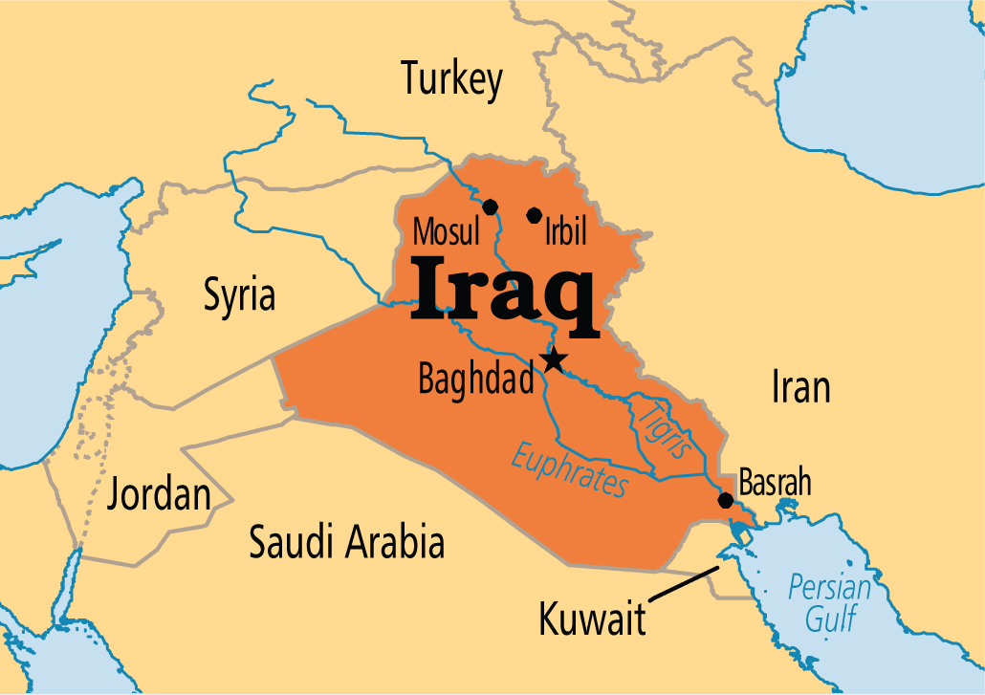
Station 1 – Saddam Hussein
https://www.youtube.com/watch?v=tZaol9U0dy4

Slide 4
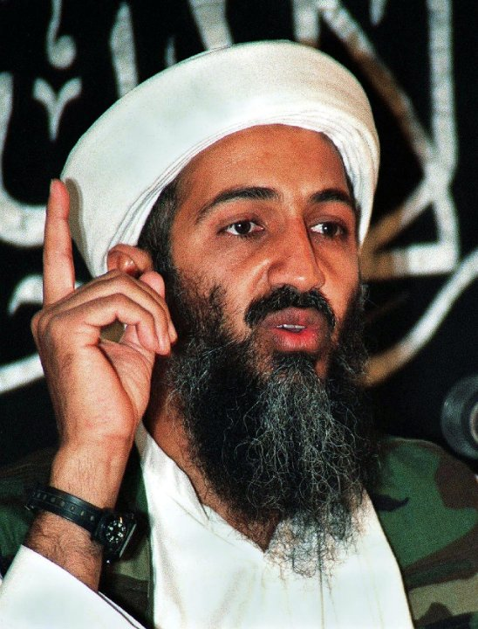
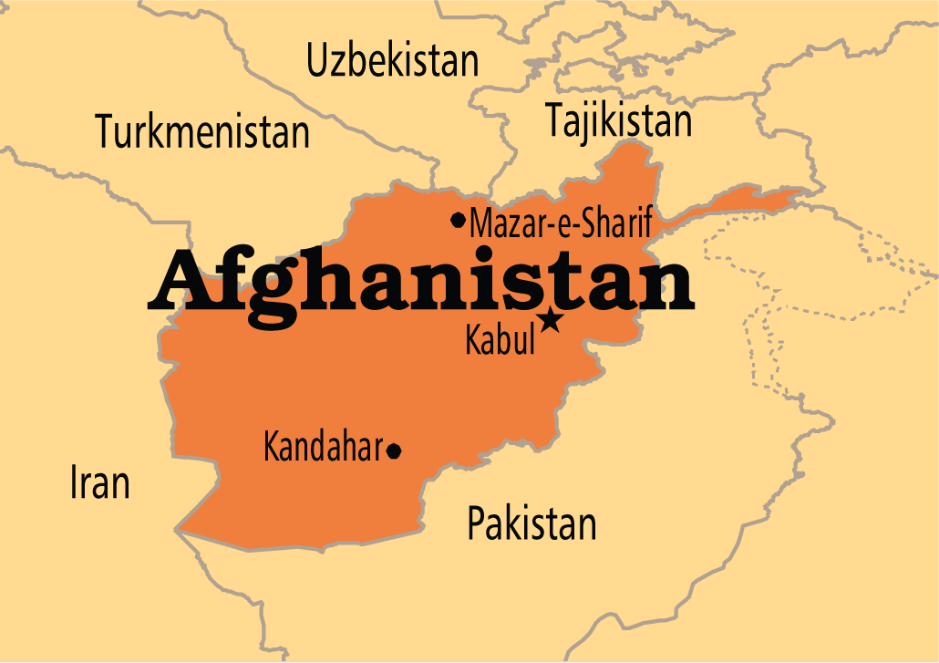
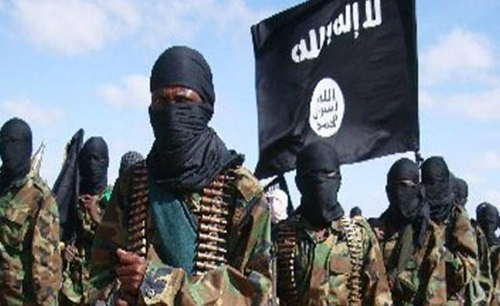
Station 1 – Osama bin Laden
https://www.youtube.com/watch?v=Lg9VAXKQ8Z8

Slide 5
Work Session
*Now continue on to Station 2: Persian Gulf War
*If you have time, when finished, begin Station 3: Invasion of Afghanistan

Slide 6
Closing
*Student-led responses to stations so far.

