Slide 1
February 23, 2016
Immediately begin writing the standard & Bell-Ringer
SS7E1a. Compare how traditional, command, and market economies answer the economic questions of (1)what to produce, (2) how to produce, and (3) for whom to produce
c. Compare & contrast the economic systems in South Africa & Nigeria
Bell-Ringer
In your social studies notebook, write down all that you remember from the economics unit. Discuss the different economic systems, trade barriers, etc.

Slide 2
Economic Systems Review
Traditional Economy- Economic decisions are made based on custom & habit of how decisions were made in the past
Command Economy- Government planners make the economic decisions for workers
Market Economy- Economic decisions are made by individuals, consumers & the market, who decide what to produce and what to buy.
Mixed Economy- Located on a continuum between pure market and pure command; most economies are located between the two types

Slide 3
Trade & Trade Barriers
Voluntary Trade- Two parties willingly exchange goods & services for their personal benefit
Specialization-Focus on producing goods & services that a country makes best/has a high demand for
Trade Barriers- Anything that slows down or prevents one country from exchanging goods with another
Tariff-Tax on imports to protect the local economy
Quota-Limit of imports brought into a country to protect a local economy
Embargo-Trade is completely ended as a protest or due to political issues

Slide 4
Economic Growth & Investment Review
Human Capital-Knowledge and skills (education) of workers needed for producing a good or service
Capital Goods-Technology (factories, machines, & tools) used/needed for producing a good or service
Gross Domestic Product (GDP)- The total value of all goods & services of a country in a year
Per capita GDP- The total value of a country per person
Entrepreneurs-People who are willing to take a risk to begin a new business and products

Slide 5
COMMAND MARKET
Less Econ More Econ
Freedom Freedom
Black- Saudi Arabia Dark Blue- United States
Green- Turkey
Light Blue- Israel

Slide 6
Note taking
Yellow – Graphic Organizer
Blue – Cornell Notes
Green – 3-Column Notes

Slide 7
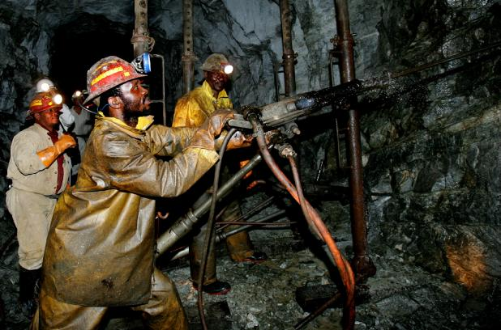
SOUTH AFRICA
What to Produce? -GDP comes from mining (diamonds, platinum & gold), agriculture, services, and manufacturing
South African government operates and maintains state-run enterprises in housing, business development, education, basic services, and healthcare. (Apartheid)
How to Produce? Business owners and consumers make production and purchase decisions based on current market economic standards.
For Whom to Produce? Produce goods and services for domestic and international markets based on the market price system.

Slide 8
SOUTH AFRICA ECONOMY FACTS
GDP per capita-$9,800
Human Capital-Invests heavily in training and skills for industry; Still has highest unemployment rate(25%) due to effects of apartheid
Capital Goods-Invests heavily in equipment needed for mining industry, machinery production, & assembly lines

Slide 9
NIGERIA
What to Produce?-Oil production & petroleum products most of GDP; imports food products
-Member of OPEC
How to Produce?-Poorly organized after years of government corruption & dictatorship; trying to reorganize with more private business
For Whom to Produce? -46% of Nigeria’s daily oil production is exported to the United States

Slide 10
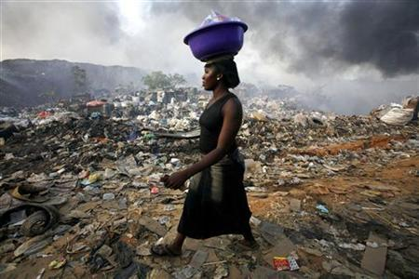
NIGERIA ECONOMY FACTS
GDP per capita-$2,000
Human Capital-Very educated population; lack of investment in job training, healthcare, decent pay, housing, & food supplies
Capital Goods-Heavily invested in new technology for oil industry

Slide 11
Remainder of Class
Work on the study guide for our test this Monday (2/29).
Rest of the Week –
Wednesday – Diamonds, Oil, and Uranium
Thursday – Missing Work/Study Guide Day
Friday – Review Day
Monday – Government/Econ Test

Slide 12
Closing
Draw a continuum and place South Africa and Nigeria on the continuum.

