Slide 1
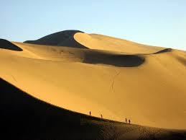
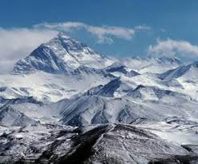
Mapping Review
SS7G1 - The student will locate selected features of Africa.
SS7G5 - The student will locate selected features in Southwestern Asia (Middle East).
SS7G9 - The student will locate selected features in Southern and Eastern Asia.
Bell-Ringer – If you were to travel any where that we learned about this year, where would you want to visit and why?

Slide 2
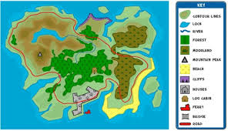
Work Session
Using the geography textbooks, map the countries and physical features that we learned this year.
Do NOT forget to create a key/legend.

Slide 3
Where Can You Find Them?
Physical Features
Countries

Slide 4
Closing
http://www.sheppardsoftware.com/Geography.htm

