Slide 1
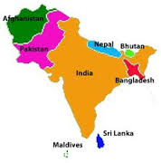
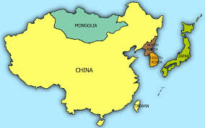
Mapping Southern and Eastern Asia
SS7G9 – The student will locate on a world and regional political-physical map selected features in Southern and Eastern Asia.

Slide 2
Bell-Ringer
Respond to the following writing prompt in your social studies notebook:
What countries do you think are located in Southern and Eastern Asia? Can you name some physical features there?

Slide 3
Sheppard Software
Discover the countries of Southern and Eastern Asia using Sheppard Software:
http://www.sheppardsoftware.com/Asian_Geography.htm

Slide 4
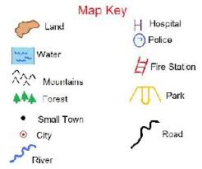
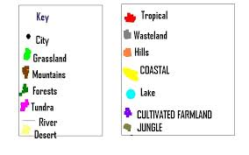
Key/Legend

Slide 5
Work Session
Yellow – 1.) Complete both physical and political maps (next slide has all physical features/countries) and 2.) create a key.
Blue – 1.) Complete both physical and political maps (next slide has all physical features/countries), 2.) create a key, and then 3.) using the geography book research one of the countries and write a paragraph about that country.
Green – 1.) Complete both physical and political maps (next slide has all physical features/countries), 2.) create a key, 3.) using the geography book research one of the countries and write a paragraph about that country, 4.) using the geography book research one of the physical features and write a paragraph about that physical feature.

Slide 6
Map Directions
Using pages RA26-RA29
Locate on a Physical Map: Ganges River, Huang He (Yellow River), Indus River, Mekong River, Yangtze (Chang Jiang) River, Bay of Bengal, Indian Ocean, Sea of Japan, South China Sea, Yellow Sea, Gobi Desert, Taklimakan Desert, Himalayan Mountains, and Korean Peninsula.
Locate on a Political Map: China, India, Indonesia, Japan, North Korea, South Korea, and Vietnam.
Create a Key/Legend

Slide 7
Closing
Let’s check our knowledge about the physical features of Southern and Eastern Asia:
http://www.sheppardsoftware.com/Asian_Geography.htm

