Slide 1
Mapping The Middle East Project
SS7G5: The student will locate selected features in Southwestern Asia (Middle East).
Bell-Ringer: Write a sentence using one of our vocabulary words from yesterday.

Slide 2
Vocabulary Review
What words do we remember and can you provide the definitions? (Vocab Quiz Next Wednesday)

Slide 3
Introduction of Mapping Project
Follow along with me as I read the instructions for our project.

Slide 4
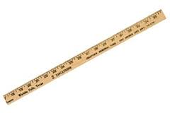
Suggestions
Begin this project in pencil in case you mess up. You will NOT receive another sheet of paper for this project.
Follow the instructions in the paper that I gave you and when finishing a section, cross it out to show you completed it.
Measure out 6 feet on your map and cut there, your paper should not be longer than 6 feet.

Slide 5
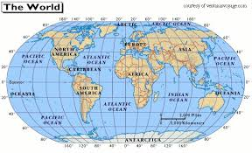
Latitude and Longitude
You will have to find latitude and longitude for this project:
https://www.youtube.com/watch?v=Z12xvX4MagU

Slide 6
Project Expectations
When doing group work:
Remain quiet, the volume does NOT go above a whisper.
Stay with your group, do not talk or work with other groups.
Stay on-task, you should be focused on this work the entire time.
Remember, this is 40% of your grade, so work hard and make sure you create a quality map that follows all the directions on the Mapping Activity Instructions.
Anybody not following the above expectations will have their cards marked and the period will lose points.

Slide 7
Questions
Is anybody confused or need me to go over anything again?

Slide 8
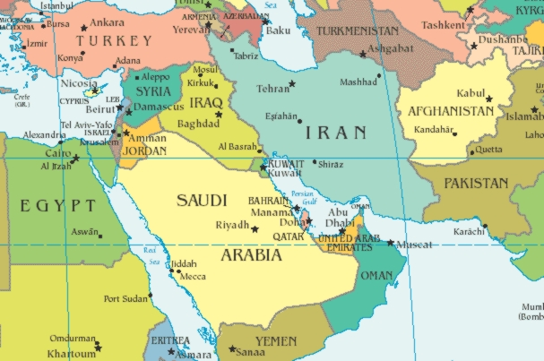

Slide 9
Closing
Gallery Walk
Any comments or suggestions for groups?
Does anybody have any questions still?

