Slide 1
SS7CG4.c. – Describe the two predominant forms of democratic governments: parliamentary and presidential.

Slide 2
Middle East Government Vocabulary
Day 2

Slide 3
Bell-Ringer
Please write down and answer the following:
Name as many types of governments as you can.
What are the distributions of power and forms of citizen participation for those governments.

Slide 4
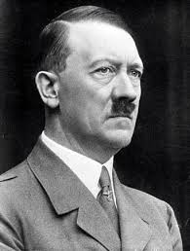
Dictatorship/Totalitarianism
A type of government system where a single ruler or party has total control; usually uses military to enforce power.

Slide 5
Parliamentary Democracy
A government system where Parliament is the legislature and the leader of the government is the Prime Minister who is selected by the majority party in Parliament.

Slide 6
Presidential Democracy
A type of government system where the Congress is the legislature and the leader of the government is the President who is voted in a separate election.

Slide 7
Theocracy
A government in which God is seen as the true leader of the government and the country’s religious leaders serve as the political leaders.

Slide 8
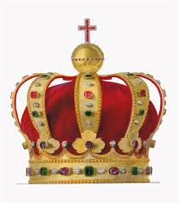
Absolute Monarchy
A type of government system where the hereditary ruler is the king or queen, who has a “divine right” (God given right) to rule the government and has total control/power.

Slide 9
Constitutional Monarchy
A type of government system where the ruler is a king or queen and serves as the “figure head” of government. Powers and ability to rule are limited by the constitution.

Slide 10
Struggle Time
What are the differences between these governments? What are the forms of citizen participation and the distribution of power for each government?

Slide 11
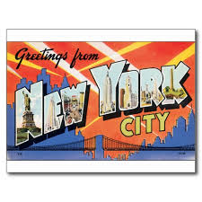
Postcard Examples

Slide 12
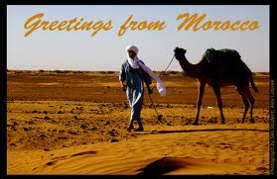
Postcard Examples

Slide 13
Postcard Examples

Slide 14
Work Session
Postcard Activity (Your postcards should include a drawing of what the government style may look like and a definition for the word chosen)
Yellow – Create two postcards that include a written entry (one from the POV of the leader and one from the POV of a citizen). Two government styles.
Blue – Create two postcards that both compare/contrast government styles (Absolute Monarchy vs Constitutional Monarchy and Parliamentary Democracy vs Presidential Democracy).
Green – Create two postcards that include countries that have that style of government. You may use your geography textbook to research the government and countries in order to have plenty of information on your postcard.

Slide 15
Yellow
Create two postcards that include a written entry (one from the POV of the leader and one from the POV of a citizen). Two government styles.

Slide 16
Blue
Create two postcards that both compare/contrast government styles (Absolute Monarchy vs Constitutional Monarchy and Parliamentary Democracy vs Presidential Democracy).

Slide 17
Green
Create two postcards that include countries that have that style of government. You may use your geography textbook to research the government and countries in order to have plenty of information on your postcard.

Slide 18
Closing
What are the differences between the types of governments. Provide real world examples of each from the vocabulary practice.

