Slide 1
Southwest Asia (Middle East) Geography Vocabulary
SS7G5: The student will locate selected features in Southwestern Asia (Middle East).
Bell-Ringer: Name the 3 note taking styles that we learned last week and explain which one you want to use for today.

Slide 2
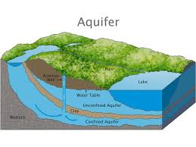
Aquifer
Ground water that moves freely through the rocks and soil that are underground.

Slide 3
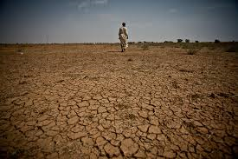
Arid
A dry landscape, lacking rainfall to support vegetation.

Slide 4
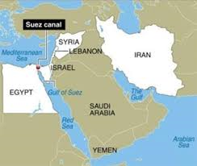
Canal
An artificial waterway constructed for the passage of ships inland.

Slide 5
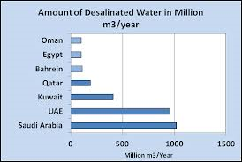
Desalinization
The removal of salt and other minerals from water to produce fresh, drinkable water.

Slide 6
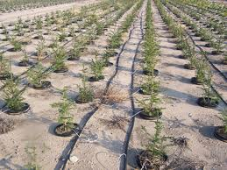
Drip Irrigation
A method that saves water and fertilizer by allowing water to slowly drip to the roots of the plants.

Slide 7
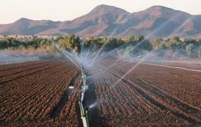
Irrigation
The artificial application of water to land and soil.

Slide 8
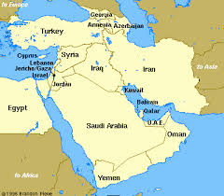
Isthmus
A narrow strip of land connecting 2 larger pieces of land.

Slide 9
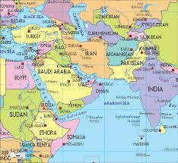
Landlocked
Having no access to a waterway or coastline; being completely surrounded by land.

Slide 10
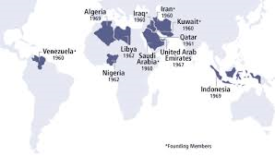
OPEC
Organization of Petroleum Exporting Countries: An organization that monitors the importing and exporting of petroleum.

Slide 11
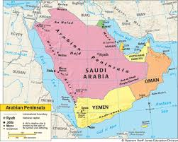
Peninsula
A piece of land that has water surrounding it on 3 sides.

Slide 12
Sparse
Thinly distributed or scattered.

Slide 13
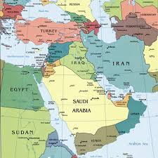
Waterway
A navigable body of water.

Slide 14
Work Session
You may either work on this by yourself or with a partner.
Music – create a song/rap/poem that includes the vocabulary words that we learned today and explains the terms. Write down finished product.
Bodily/Kinesthetic – Play charades using the vocabulary terms, write down how students moved or what they did to explain vocabulary words.
Visual/Spatial/Naturalist – Draw the vocabulary terms as pictures and write down the definition with each picture.
Verbal/Linguistic – Create a story using the vocabulary terms and explain what the vocabulary terms mean in your story.

Slide 15
Closing
Student-led presentations that help represent the standard and objective.
Music
Bodily/Kinesthetic
Visual/Spatial/Naturalist
Verbal/Linguistic

