Slide 1
Sit down in your assigned seat and begin studying your vocabulary.
If the class studies quietly, I may give you a surprise.

Slide 2
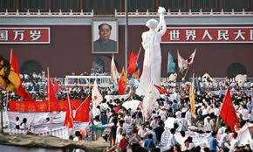
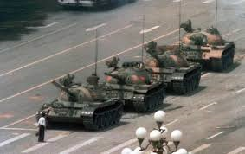
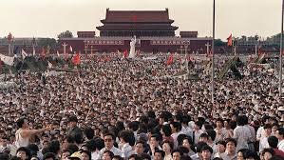
Today’s Agenda
1.) Begin with Vocabulary Quiz
2.) Video about Tiananmen Square

Slide 3
Quiz Rules
All you will need is a pen/pencil.
If the class has been quiet, you may use any notes that you have to help you with the quiz.
Do NOT share your notes with others or both of you will receive a 0.
There is no talking and no cheating.
When you are finished, raise your hand.

Slide 4
Video Rules
Watch the video and take notes because today’s closing will be collected for a classwork grade.

Slide 5
Closing
Answer the question below in COMPLETE SENTENCES. The better your response, the better your grade.
What was the Tiananmen Square massacre and what did the Communists do to the protestors?

