Slide 1
Review of Ottoman Empire and Creation of Israel
SS7H2.b - Explain the historical reasons for the establishment of the modern State of Israel in 1948; include the Jewish religious connection to the land, the Holocaust, anti-Semitism, and Zionism in Europe.
Bell-Ringer – Respond to the following questions:
1.) What happened after the fall of the Ottoman Empire?
2.) What happened when Israel became a country?

Slide 2
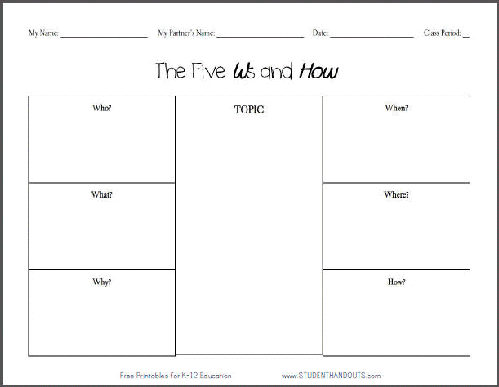

Slide 3
Work Session
1.) Create 2 “Five W’s and How”
2.) Read the Ottoman Empire Article and Israel Article
  Do NOT write on the articles!
3.) Complete your “Five W’s and How” using the articles. The more information found, the better your grade will be.
  One of the “Five W’s and How” will be for the Ottoman Empire and the other will be about Israel.
Green – You will also have to write a one paragraph summary about the rise and fall of the Ottoman Empire and one paragraph summary about the creation of Israel and conflict.

Slide 4
Closing (Ottoman Empire)

Slide 5
Closing (Israel)

