Slide 1
SS7G6.a - Explain how water pollution and the unequal distribution of water impacts irrigation and drinking water. SS7G7.a - Explain how the distribution of oil has affected the development of Southwest Asia (Middle East).
Bell-Ringer: Why is water more useful of a natural resource than oil?
Why is oil more useful of a natural resource than water?

Slide 2
Seating
Listen to your new seating for today and Thursday.

Slide 3
Vocabulary Review
Abundant –
Ethnic Group –
Fertile –
Fossil Water –

Slide 4
Hydroelectric Power –
Natural Resource –
Petroleum –
Qanat –

Slide 5
Religious Group –
Shatt al-Arab –
Strait of Hormuz –
Subsistence Farming –

Slide 6
Reminder
Wednesday – I will not be here
Thursday – Vocabulary Quiz!!!

Slide 7
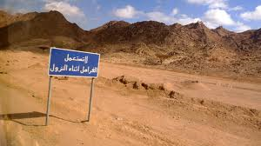

Slide 8
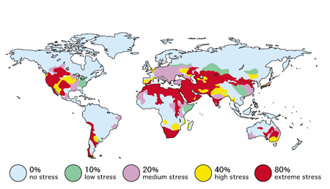

Slide 9
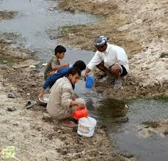

Slide 10
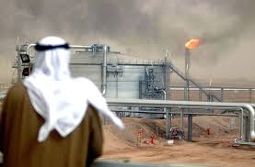

Slide 11
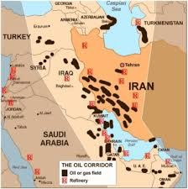

Slide 12
Opening – Petroleum vs Water
Water is used for… drinking, recreation, showers/faucets/toilets, washing clothes, electricity, irrigation, navigation, wildlife/food, cooking, and more.
Petroleum is used for… fuel/gasoline, detergents, plastics, heating/electricity, rubber, clothing fibers, fertilizers/pesticides, paint, film, make-up, medicine, and more.

Slide 13
Work Session
Using the articles given to you, answer the questions on a separate sheet of paper in complete sentences.

Slide 14
Closing
Go over the questions that we had today.

