Slide 1
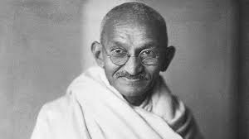
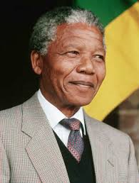
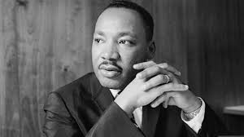
DBQ - Gandhi, King, and Mandela: What Made Nonviolence Work?
SS7H1.c – Explain the creation and end of apartheid in South Africa and the roles of Nelson Mandela and F.W. de Klerk.
Bell-Ringer – Who is Martin Luther King Jr? Who is Nelson Mandela? Who is Mohandas Gandhi? What are their individual accomplishments and how do they connect?

Slide 2
DBQ Folders
As soon as you receive your DBQ folder, please fill it out like you see on the board.
All of your work for the DBQ process will be placed in here and is NOT to leave the classroom. This way you will not lose your documents.

Slide 3
Opening
The title of this DBQ is called:
Gandhi, King, and Mandela: What Made Non-Violence Work?
PLEASE write the title of this DBQ on your DBQ FOLDER.
DBQ Process:
Students are to read and analyze 6 documents in order to write at least a 5 paragraph essay in which they use the information from the documents to support their findings (cite the material).
Buckets and Importance of Organization

Slide 4
Quotes
Instructions: Write down the following quotes on a piece of paper and then predict what each quote means and explain who you believe said the quote.
“An eye-for-an-eye only makes the whole world blind.”
“Hate cannot drive out hate; only love can do that.”
“People must learn to hate, and if they can learn to hate, they can also be taught to love.”

Slide 5
Background Essay
Silently, by yourself, read and underline the important and interesting information in the background essay.
Write down the bolded vocabulary words on a piece of paper and try to define them using context from the reading:
Caste system, untouchable, Mahatma, Jim Crow, apartheid, Afrikaner.

Slide 6
Summarize
1.) What was happening in South Africa and India for Mohandas Gandhi to begin nonviolently protesting? Summarize what you found from the readings about what nonviolent tactics he used.
2.) What was happening in the United States for Martin Luther King Jr to begin nonviolently protesting? Summarize what you found from the readings about what nonviolent tactics he used.
3.) What was happening in South Africa for Nelson Mandela to begin nonviolently protesting? Summarize what you found from the readings about what nonviolent tactics he used.

Slide 7
Closing
What new information did you learn about either Mohandas Gandhi, Martin Luther King Jr, or Nelson Mandela?
How do these men connect?

