Slide 1
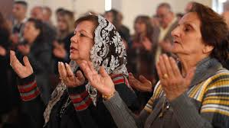
Ethnic and Religious Groups SS7G8.a - Explain the differences between an ethnic group and a religious group.
Bell-Ringer: Are all people in an ethnic group also in a religious group? Explain your reasoning.

Slide 2
Opening
Ethnic group - a group of people with the same culture or background.
Culture - the beliefs, customs, arts, etc., of a particular society, group, or place.
Religious group - a group of people that believe in/are associated with the same religion.
Ethnic Groups share common characteristics: culture, language, location, and tradition.
Religious Groups share common beliefs, but are not necessarily a single ethnic group. This means not all people in an ethnic group are in the same religious group (Ex – Arabs may be Muslims or Christians).
You can change your religious group, not your ethnic group.

Slide 3
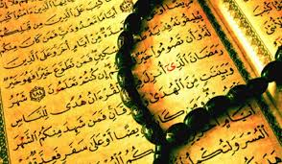
Examples
Ethnic Groups – Arabs, Persians, Bedouins, and Kurds.
Religious Groups – Judaism, Islam, and Christianity.

Slide 4
Work Session
Look at the following examples and determine if the group would be an ethnic group OR a religious group.

Slide 5
Work Session Continued
This group of people have been farming the same region of South West Asia for generations, still practice the same marriage rituals that their ancestors practiced, and still wear the same colorful clothing that their ancestors wore. Would this be an example of an ethnic group or religious group?

Slide 6
Work Session Continued
Although from different regions of South West Asia, this group of people worship on the same day, pray to the same god, and practice the same spiritual rituals. Is this an example of an ethnic group or a religious group?

Slide 7
Work Session Continued
1.) What is your ethnic group? Discuss specific examples for your ethnic group: language, clothing, food, history, traditions, etc.
2.) What is your religious group? Discuss place of worship, beliefs, holy book, holidays, etc. If you do not have a religious group, discuss one that you know about.
3.) Do you believe most people in your ethnic group share the same religious group? Why or why not?
4.) Can you change your ethnic group? Why or why not?
5.) Can you change your religious group? Why or why not?
Discuss your results with your neighbor when finished.

Slide 8
Closing
1.) Explain the differences between an ethnic group and a religious group.
2.) Discuss ethnic and religious groups.

