Slide 1
Imperialism/Colonialism of Africa
SS7H1.a Explain how the European partitioning across Africa contributed to conflict, civil war, and artificial political boundaries.
Bell-Ringer - Think back to last semester. How did European involvement result in conflict? Why has there been so much conflict since then?

Slide 2
New Imperialism
End of 1800s called “New Imperialism”
  Fierce competition between European countries for land and power.
  “Scramble for Africa”
**Great Britain and France fought for control of Africa and trade routes.
Britain – Suez Canal, Egypt, gold, and ivory.
France – increase trade, slave trade, and spread French culture.
Belgium – Congo River Basin
Berlin Conference (1884-1885) – European nations discussed Africa’s land and how they wanted it divided. In one year, Europe had gone from having 10% of Africa to most of Africa.

Slide 3
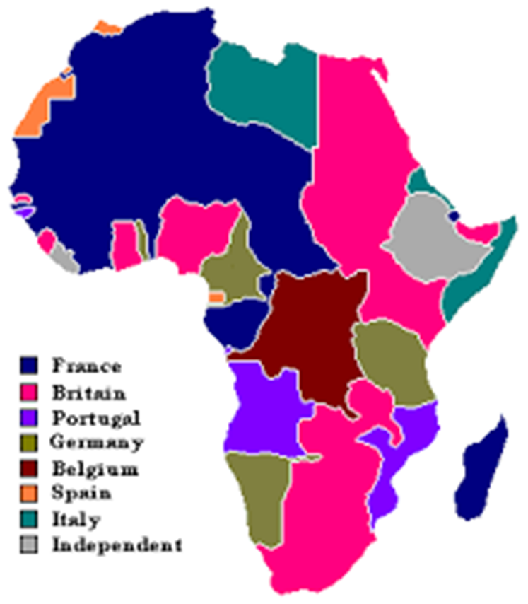
New Imperialism

Slide 4
Political Cartoons
Next, you will see some political cartoons in this powerpoint, analyze what is going on in the political cartoon. Try to use your vocabulary words and as much of your knowledge so far about imperialism, nationalism, and colonialism. Write your responses on a separate sheet of paper with your name, date, and period on the paper.
Write as much as you can about each political cartoon! Focus on what is happening in the cartoon, what you see, and what it means.

Slide 5
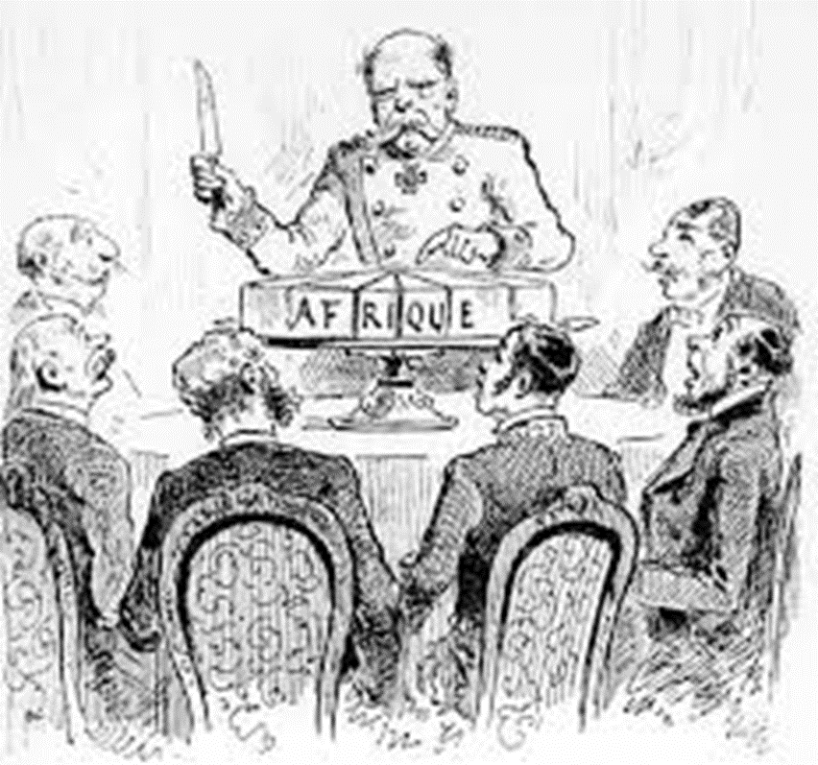
Political Cartoon #1

Slide 6
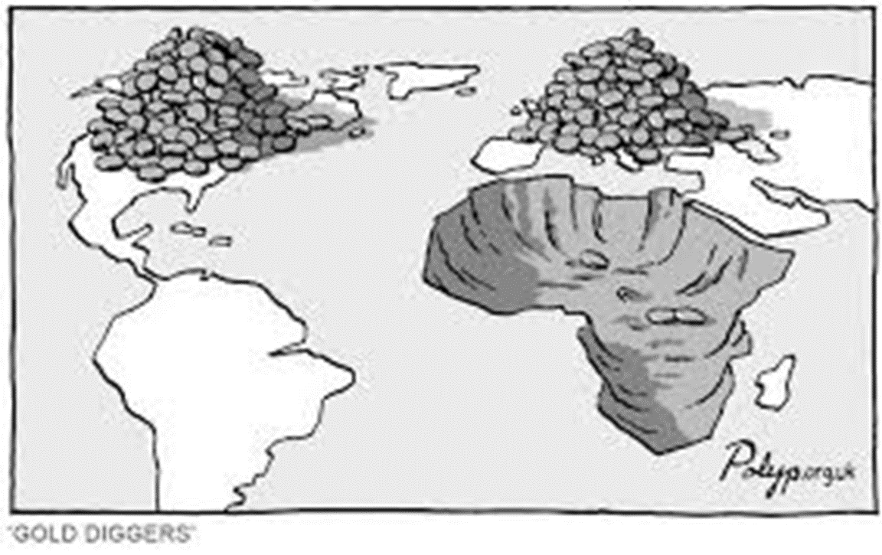
Political Cartoon #2

Slide 7
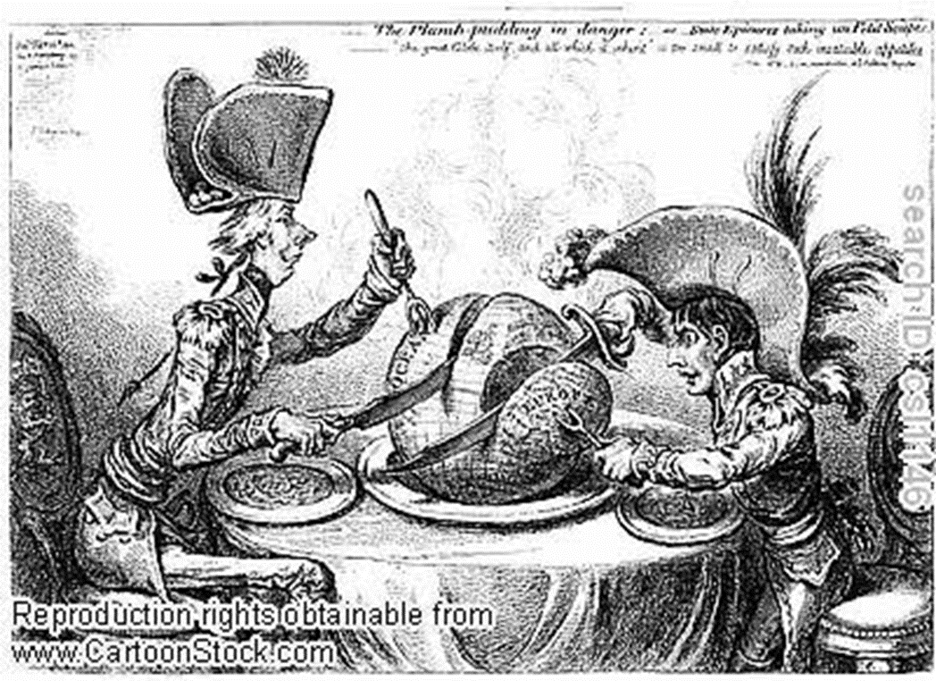
Political Cartoon #3

Slide 8
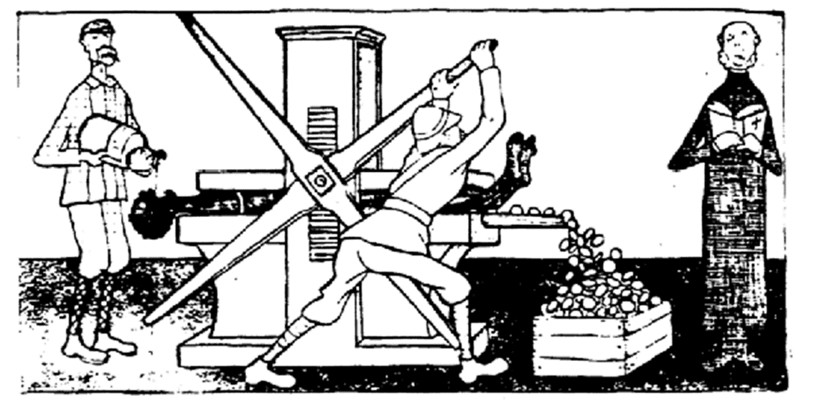
Political Cartoon #4

Slide 9
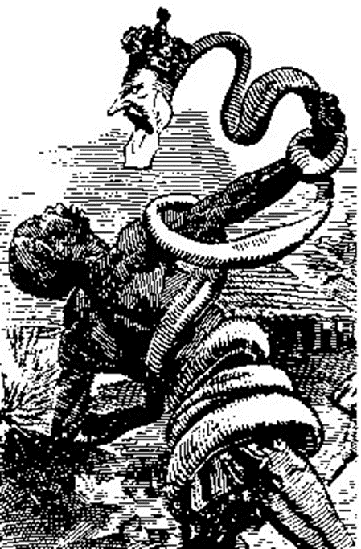
Political Cartoon #5

Slide 10
Work Session
Read the article, “Imperialism and Colonialism in Africa Part I, 1880-1914” and answer the questions given in COMPLETE SENTENCES.

Slide 11
Closing
Based on the article reading and political cartoons, we can see how Europeans felt about imperialism and why they were motivated to take over other countries.
However, step into the perspective of a native of Africa. Write a small reflection from the perspective of a native African during the Age of Imperialism. Describe how you feel about Imperialism and why.

