Slide 1
Mapping the Middle East Project Day 2
SS7G5: The student will locate selected features in Southwestern Asia (Middle East).
Bell-Ringer: List what you and your group still have left to do for this project.

Slide 2
Have You…
Drawn your borders for the Middle East?
Labeled all of the countries and areas on your Mapping Activity Instructions?
Drawn and labeled all of the physical features on your Mapping Activity Instructions?
Labeled the cities and provided correct latitude and longitude needed from the Mapping Activity Instructions?
Made your key and shown what you used for cities and rivers?
Colored in your map? (Do not use dark colors that would cover up country names, do not use blue for countries)

Slide 3
Suggestions
Begin this project in pencil in case you mess up. You will NOT receive another sheet of paper for this project.
Follow the instructions in the paper that I gave you and when finishing a section, cross it out to show you completed it.

Slide 4
Project Expectations
When doing group work:
  Remain quiet, the volume does NOT go above a whisper.
  Stay with your group, do not talk or work with other groups.
  Stay on-task, you should be focused on this work the entire time.
  Remember, this is 40% of your grade, so work hard and make sure you create a quality map that follows all the directions on the Mapping Activity Instructions.
  Anybody not following the above expectations will have their cards marked and the period will lose points.

Slide 5
Questions
If anybody was not here yesterday, find a group to join.
TODAY is your last day to finish up this part of the project.
Is anybody confused or need me to go over anything again?
IF you finish early, please quietly study your maps and vocabulary with the people in your group.
REMINDER – Map quiz tomorrow and vocabulary quiz Wednesday.

Slide 6
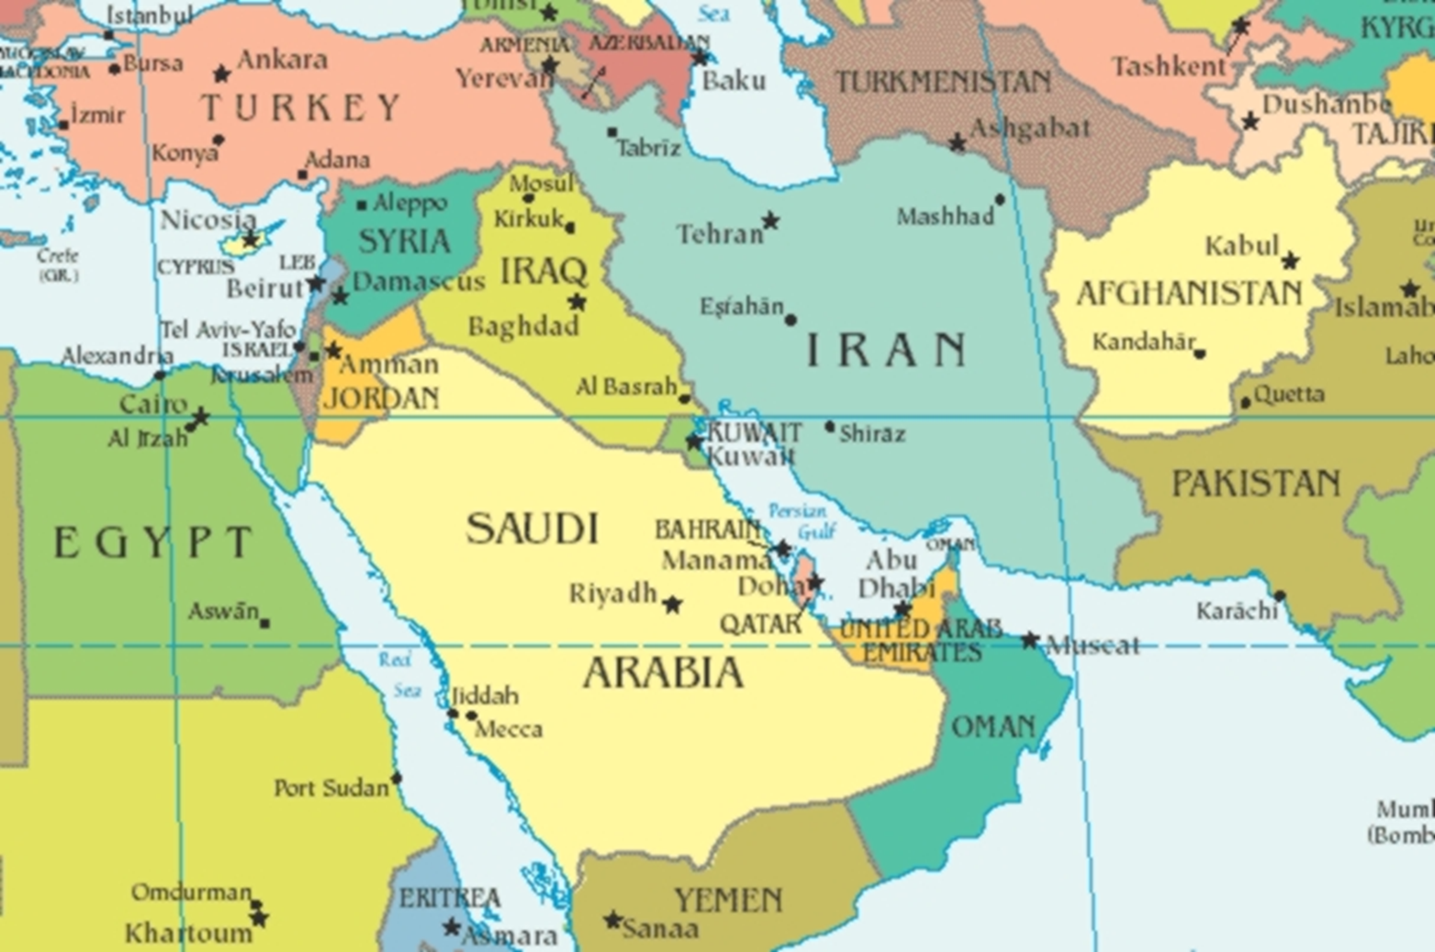

Slide 7
Closing
Tear out a piece of paper, do NOT put your name on it.
Answer these questions:
  1.) List the names of the members in your group.
  2.) What did each person in your group do for the project?
  3.) Who worked the hardest in your group?
  4.) Is there anybody who did not work hard in your group?
When finished, place it in the correct classwork bin in the back of the room.

