Slide 1
Vocabulary Quiz
Bell-Ringer: Sit down and begin to study quietly.
Reminder: The more quiet you remain, the longer you can have to study.

Slide 2
Quiz Instructions
The only things on your desk should be your behavior card and a pen/pencil.
Write your name (first and last), date, and period on the paper.
There is no talking and no cheating.
There is a back side to the quiz.
When you finish the quiz, raise your hand and I will collect your paper.
Do not talk to anybody and wait for further instructions.

Slide 3
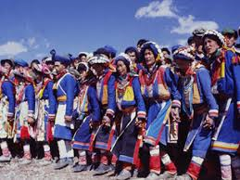
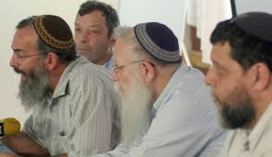
Bell-Ringer
What is the difference between an ethnic group and a religious group?

Slide 4
KIM Chart Instructions
Follow along with vocabulary words and complete the information and memory clue.

Slide 5
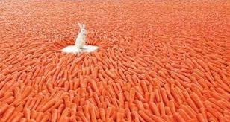
Abundant
Having plenty or more than enough of a resource.

Slide 6
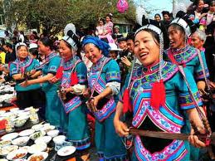
Ethnic Group
A group of people who share the same cultural ideas/beliefs that have been passed down for generations.

Slide 7
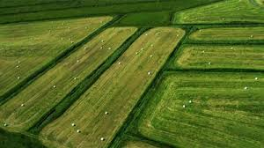
Fertile
Land that is able to produce crops that are needed.

Slide 8
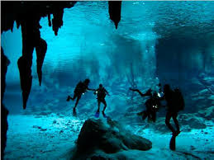
Fossil Water
Groundwater that has remained sealed in an aquifer for thousands or even millions of years due to changes in the environment.

Slide 9
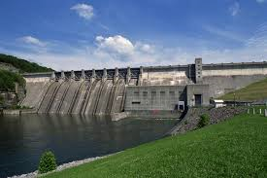
Hydroelectric Power
Electricity created using energy from running water.

Slide 10
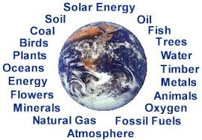
Natural Resource
Something that is in or supplied by our natural environment and can be consumed or used by the people.

Slide 11
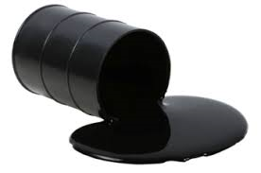
Petroleum
An oil that is drilled and refined as a source of fuel.

Slide 12
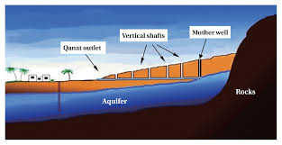
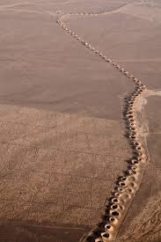
Qanat
Man-made underground tunnels that bring water from the hills to the dry plains.

Slide 13
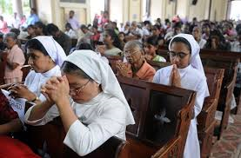
Religious Group
A group of people who share a belief system in a god or gods, with a specific set of rituals and book.

Slide 14
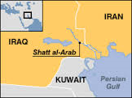
Shatt al-Arab
A waterway created by the Euphrates and Tigris rivers when they join together; creates border between Kuwait & Iran.

Slide 15
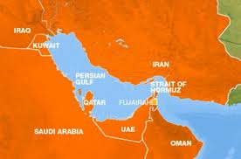
Strait of Hormuz
Narrow waterway that connects the Persian Gulf to the Arabian Sea.

Slide 16
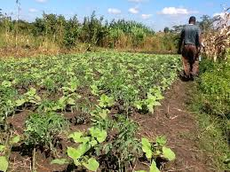
Subsistence Farming
Growing small amounts of crops to take care of individual and local needs.

Slide 17
Work Session
Options:
In a group of two
Create a song, poem, or rap to help you remember at least 5 vocabulary words
Create a story that uses at least 5 vocabulary words
Make flashcards using the vocabulary terms
Play charades to help you remember the vocabulary terms

Slide 18
Closing
Close your notebooks, put them under your desk and let’s see what you remember!

