Slide 1
Religions of Southern and Eastern Asia
SS7G12.B - Compare and contrast the prominent religions in Southern and Eastern Asia: Buddhism, Hinduism, Islam, Shintoism, and the philosophy of Confucianism.
Bell-Ringer – Write down what you remember about the religions from your web quest.

Slide 2
Religion Videos
Confucianism & Shintoism
  https://www.youtube.com/watch?v=GTjmHjY-A7I
Hinduism & Buddhism
  https://www.youtube.com/watch?v=PnN1bgqnUDc

Slide 3
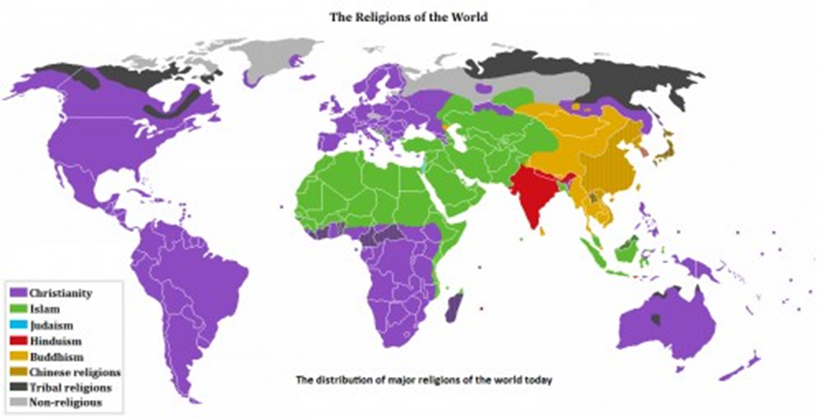
Religions of Asia

Slide 4
Religions Work Session
Follow along as we read, and underline important information as we read in regards to: year created, location started, name of creator, major beliefs, whether they believe in a caste system, countries the religion is practiced, religious world rankings, and definitions.
When we are finished reading, work on the religions charts.

Slide 5
Closing
Go over the “religions chart”

