Slide 1
Scramble for Africa
SS7H1.a - Explain how the European partitioning across Africa contributed to conflict, civil war, and artificial political boundaries.
Bell-Ringer - How does owning something or having something help a person build their reputation? How can competing to own or have something lead to conflict?

Slide 2
Colonization of Africa - Intro
More than 1000 years ago, Africa established many large empires which were areas of trade and learning.
Attracted to the trading opportunities, European countries became interested in Africa.
Mid-1800s – Europeans had explored and mapped most of Africa.
This is what led to colonialism.

Slide 3
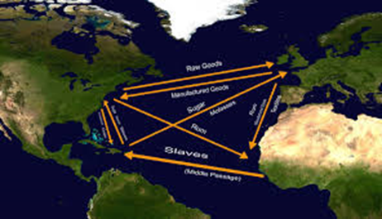
Slave Trade
**One of the reasons Europe wanted to colonize Africa was to enslave Africans as a source of labor in European colonies (the Americas).
First slaves by Europeans were Native Americans in the 1500s, but many died from diseases, so turned to Africa.
“Triangular Trade”
1619 – First slave ship arrives in Jamestown, VA.
Late 1700s – 6 million Africans taken from homes and sent to Americas.

Slide 4
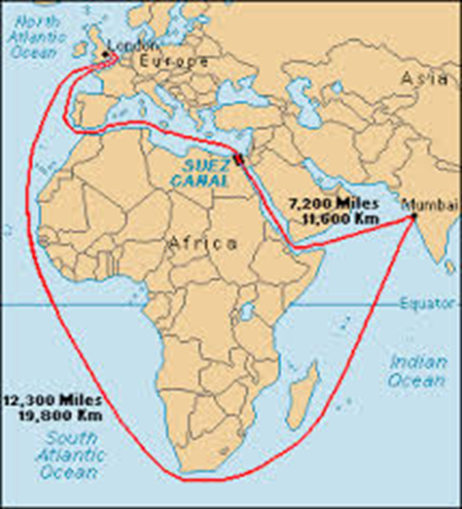
Other Reasons for Colonization
**Natural Resources –
Cotton, Rubber, Ivory, Minerals, Diamonds, Gold, Tin, and Copper.
New Trade Routes –
Suez Canal in Egypt (1869)
Civilization
Spreading Religion
Missionary Work

Slide 5
Scramble for Africa Game
Get into groups of 4
Roles –
1.) British - blue
2.) French - red
3.) Portuguese - green & Spanish - yellow
4.) Italian - purple/German - orange/Belgian - color of choice
Keep your Africa maps and country distributions face down.
When I say go, flip over the list, find your territories on the map, and color them without scribbling.
At the end of 2 minutes, you must put crayons down and see who in your group “won” the race for Africa.
Now, finish coloring in all African countries with the correct European country that owned them.

Slide 6
Scramble for Africa Questions
Looking at the country distribution list, which European country would have really “won” if there was no time limit?
You have 10 minutes to answer the 3 questions that go along with the game.

Slide 7
Closing
Discuss with your group partners your responses from the 3 questions.
Brag on a buddy.

