Slide 1
The Independence of South Sudan
SS7CG2.a - Explain how political, economic, and social conflicts resulted in the independence of South Sudan.
Bell-Ringer – What sort of issues can cause a country to want to split up?
Reminder – Quiz tomorrow! And if you finished yesterday’s class work, hand it in!

Slide 2
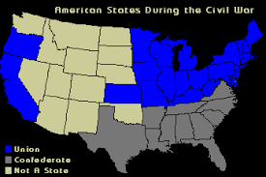
What is This Map Showing?

Slide 3
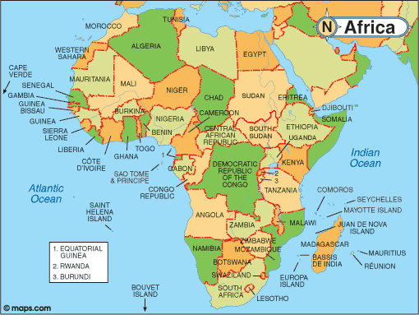
So Where is Sudan/South Sudan???

Slide 4
Opening (stop at 3:45)
Write down in your notebook what issues South Sudan has had in the past and their hopes for the future:
https://www.youtube.com/watch?v=jufGelg3w6U

Slide 5
Work Session
I will read the article out loud. Make sure you are following along.
We will work on the 5 W’s and How together.
Then you have 17 questions that you must answer in complete sentences.
Suggestion – Underline the sections in the article where you find the answer to the question.
You may work with one other person quietly; however, if the volume is too high OR not enough work is being completed, the class will have to go back to their assigned seats and work by themselves.

Slide 6
Closing
Economic issues that led to independence?
Political issues that led to independence?
Social issues that led to independence?
Who is to blame for the issues that happened in Sudan? Why?

